Slide 1
Implementing a Scalable Statewide Emergency Department Take-Home Naloxone Program
Chad Brummett, MD
Keith Kocher, MD, MPH
Chin Hwa (Gina) Dahlem, PhD, FNP-C, FAANP
University of Michigan
Department of Anesthesiology
University of Michigan
Department of Emergency Medicine
University of Michigan
School of Nursing

Slide 2
Introduction and Background Chad M. Brummett, M.D. Senior Associate Chair for Research Bert N. LaDu Professor of Anesthesiology Division of Pain Medicine University of Michigan Medical School www.michigan-OPEN.org http://medicine.umich.edu/dept/pain-research Twitter: @drchadb

Slide 3
Funding and Disclosures
Funding
NIH Common Fund UM1 NS118922
NIAMS/NIH: R01 AR060392; P50 AR070600
NIDA/NIH: R01 DA038261; R01 DA042859
Michigan Department of Health and Human Services
SAMHSA
CDC
Precision Health Initiative
Department of Anesthesiology
Disclosures
Patent for the use of peripheral perineural dexmedetomidine alone and in combination with local anesthetics. Application number 12/791,506; Issue Date 4/2/13; Patent Number 8410140
Consultant- Heron Therapeutics, Vertex Pharmaceuticals, Alosa Health, and the Benter Foundation; Expert Testimony

Slide 4
Our Goals
Reduce Opioid Use
Eliminate unnecessary
opioid exposures
Educate Providers,
Patients and Communities

Slide 5
Transitions of Care
Transitions of Care
SCREEN for opioid related risk
COMMUNICATE with patients and caregivers
COORDINATE CARE across providers
Notes:
Develop and implement best practices
A comprehensive Perioperative Care Management pathway is critical to providing best care to all surgical patients, thereby mitigating the financial and human burden of the opioid epidemic.

Slide 6
Our Initiatives
Prescribing
Recommendations
Community
Outreach
Naloxone
Transitions
of Care
Dentistry
Opioid Use
Disorder
Painless: The
Opioid Musical
Educate Providers,
Patients and Communities
Inform Policy

Slide 7
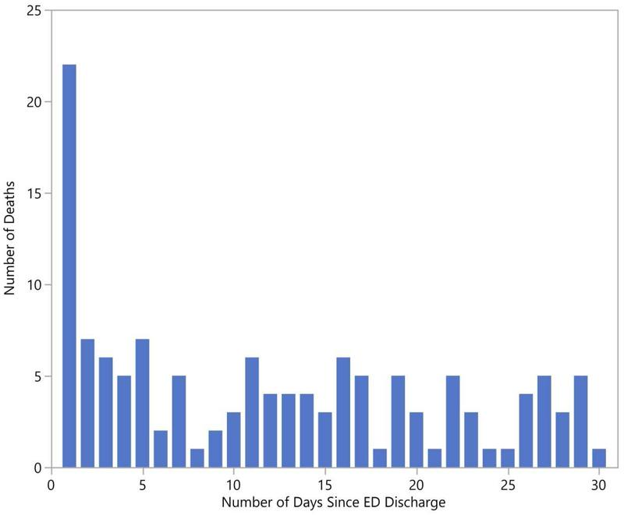
Mortality following ED visit for opioid overdose is common
Weiner SG, et al. One-Year Mortality of Patients After Emergency Department Treatment for Nonfatal Opioid Overdose. Ann Emerg Med. 2020 Jan;75(1)

Slide 8
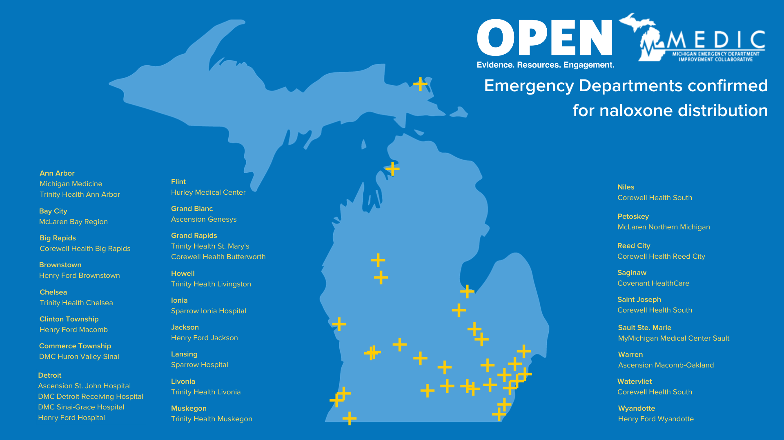

Slide 9
Our Partnership by the Numbers
KITS DISTRIBUTED:
4,500+
EMERGENCY DEPARTMENTS:
31
MOUD TRAINING ATTENDEES
450+
Emergency departments can distribute kits to patients who receive care for opioid overdose or individuals at higher risk for overdose
This project has made progress in the development of best practices on opioid use disorder (OUD) screening, initiation of medication for opioid use disorder (MOUD) and naloxone distribution through its summit series

Slide 10
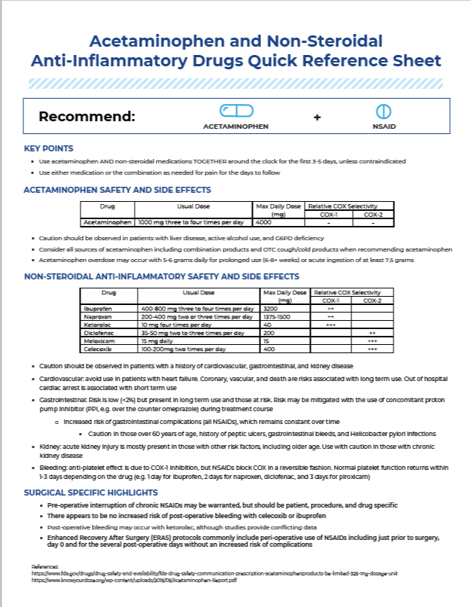
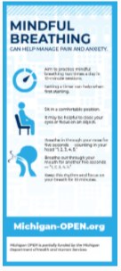
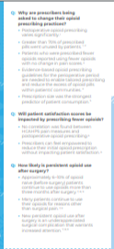
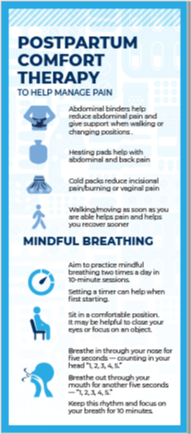
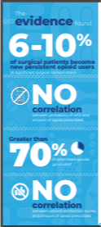
Resources
Resources
Provider Resources
Patient Resources
Prescribing Recommendations

Slide 11
Thank you!
http://michigan-open.org
Follow me:
@drchadb
Notes:
these populations often have difficulty accessing services, receive substandard SUD care and treatment when they do get it, and encounter siloed and fragmented services.
equitable access, evidence-based clinical interventions and integrated, comprehensive care for concurrent behavioral health conditions.
Stakeholders can address payment, data continuity, parity in criminal justice settings, expansion of access to services in rural settings, and further advancement of evidence-based treatment,

Slide 12
Quality Improvement in the Emergency Department Keith E. Kocher, MD MPH Associate Professor Departments of Emergency Medicine & Learning Health Sciences University of Michigan Director, Michigan Emergency Department Improvement Collaborative (MEDIC) www.medicqi.org
@kekocher
@medic_qi
Notes:
CHAD

Slide 13
Funding and Disclosures
Funding
Blue Cross Blue Shield of Michigan/Blue Care Network
AHRQ: R01 HS027811
NHLBI/NIH: R01 HL163438
Department of Defense: W81XWH2211024
Michigan Department of Health and Human Services
SAMHSA
Academic appointment, researcher, and physician at the VA Ann Arbor Healthcare System, Ann Arbor, Michigan
Disclosures
None

Slide 14
The Team
OPEN + MEDIC
Chad Brummett, MD
Gina Dahlem, PhD FNP-C
Keith Kocher, MD MPH
Aaron Dora-Laskey, MD MS
Ellie English, BS
Beth Seese, MS
Hospitals
McLaren Bay City
Corewell Health Big Rapids
Henry Ford Brownstown
Trinity Health Chelsea
Henry Ford Macomb
DMC Huron Valley-Sinai
Ascension St. John
DMC Detroit Receiving
DMC Sinai-Grace
Henry Ford Detroit
Hurley Medical Center
Ascension Genesys
Hospitals
Trinity Health St. Mary’s
Corewell Health Butterworth
Trinity Health Livingston
Trinity Health Ann Arbor
University of Michigan
Sparrow Ionia Hospital
Henry Ford Jackson
Sparrow Hospital
Trinity Health Livonia
Trinity Health Muskegon
Corewell Health South Niles
McLaren Northern
Corewell Health Reed City
Covenant HealthCare
Corewell Health South Saint Joseph
MyMichigan Medical Center Sault Ste. Marie
Ascension Macomb-Oakland
Corewell Health South Watervilet
Henry Ford Wyandotte
Funding and Partner Organizations
Michigan Department of Health and Human Services
Substance Abuse and Mental Health Services Administration
Blue Cross Blue Shield of Michigan and Blue Care Network
Injury Prevention Center, University of Michigan
Michigan Opioid Collaborative

Slide 15
Learning Objectives
Describe the implementation of ED-based naloxone distribution
Discuss common barriers and facilitators to implementation and sustainability
Identify strategies for creating scalability for program expansion

Slide 16
Learning Objectives
Describe the implementation of ED-based naloxone distribution
Discuss common barriers and facilitators to implementation and sustainability
Identify strategies for creating scalability for program expansion

Slide 17
Quality Improvement Problem
EVIDENCE
support from published literature, clinical practice, sources of authority
IMPACT
meaningful projected outcomes for all stakeholders
OPPORTUNITY
current performance & practice can feasibly be improved

Slide 18
Why quality improvement of the emergency care of patients with opioid use disorder?
~150 million emergency department visits in the US in 2019*
1 out of every 80 emergency department visits were related to opioids^
27.5% for overdose
Representing about $5 billion in medical care bills^
Evidence
Impact
Opportunity
* CDC, National Hospital Ambulatory Care Survey, 2019.
^ Langabeer JR, et al. Prevalence and Charges of Opioid-Related Visits to US Emergency Departments. Drug and Alcohol Dependence, 2021.

Slide 19
Why quality improvement of the emergency care of patients with opioid use disorder?
^
Harm reduction
Improving access to the opioid reversal medication naloxone
Emergency department take home naloxone programs*
Evidence
Impact
Opportunity
* Papp J, et al. Protocol for Take-home Naloxone In Multicentre Emergency (TIME) Settings: Feasibility Study. BMC Health Services Research, 2019.
Eswaran V, et al. Take-Home Naloxone Program Implementation: Lessons Learned from Seven Chicago-Area Hospitals. Annals of Emergency Medicine, 2020.
^ CDC: https://www.cdc.gov/opioids/naloxone/factsheets/pdf/naloxone_factsheet_emergencydepartment.pdf

Slide 20
Why quality improvement of the emergency care of patients with opioid use disorder?
Evidence
Impact
Opportunity
High short-term mortality risk!
Of all patients discharged from the ED with a diagnosis of opioid overdose in the state of Massachusetts
0.25% (29) died within 2 days
1.1% (130) died within 1 month
5.5% (635) died within 1 year

Slide 21
What is MEDIC?
Practice
Change
Est. 2015
Learning Collaborative

Slide 22
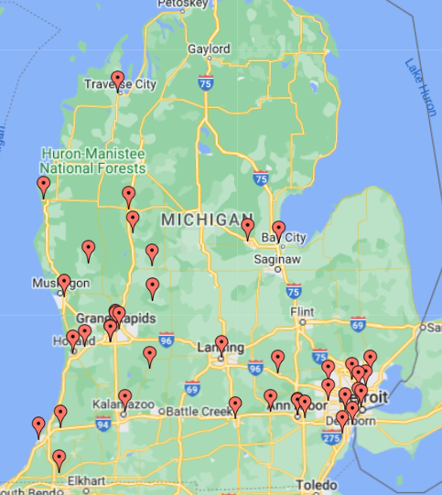
MEDIC Membership 2023
participating sites
40
different health systems
8
major pediatric EDs in MI
ALL
66%
of all pediatric ED visits in MI represented
46%
of all ED visits in MI represented
Notes:
Since inception, grown from 6 to 23 participating sites, including all dedicated pediatric EDs in the state.

Slide 23
Value Partnerships

Slide 24
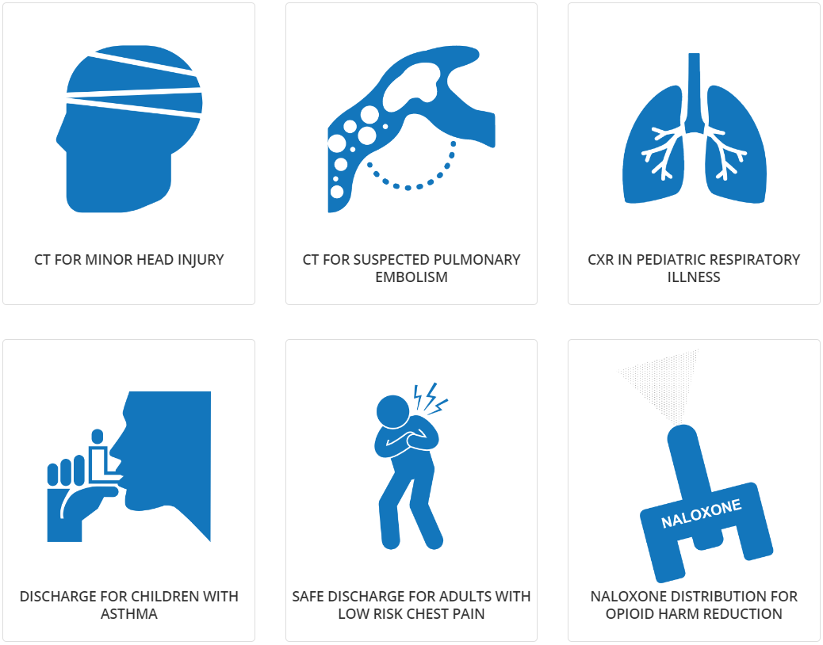
MEDIC Quality Initiatives

Slide 25
How Did We Do This? Gina Dahlem PhD, FNP-C, FAANP Clinical Associate Professor University of Michigan School of Nursing ginayi@med.umich.edu

Slide 26
Funding and Disclosures
Active Funding
Department of Justice/Comprehensive Opioid Abuse Program
Department of Justice/Comprehensive Opioid, Stimulants, and Substance Abuse Program
SAMHSA
CDC/Michigan Department of Health and Human Services
I receive royalties as a co-inventor of Rapid Assessment for Adolescent Preventive Services

Slide 27
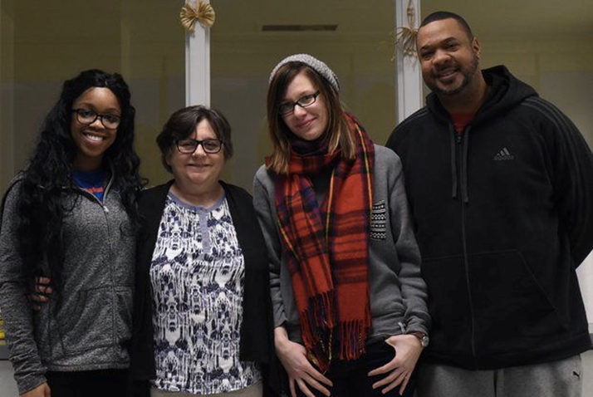
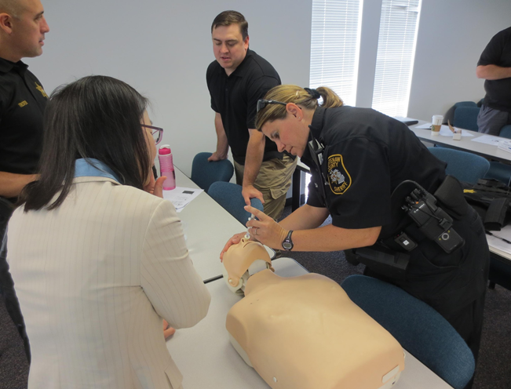
How Do I Fit?

Slide 28
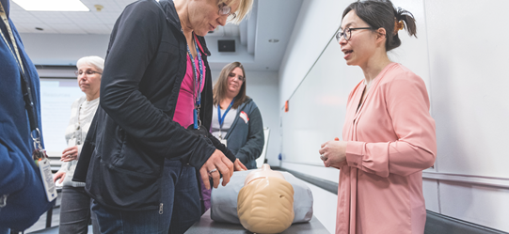
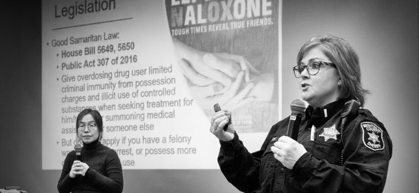
Train-the-Trainer Naloxone Training and Distribution¹
It works!
Easy to train others
Nurses are educators
¹Dahlem et al, 2020, Substance Abuse; 41(4).

Slide 29
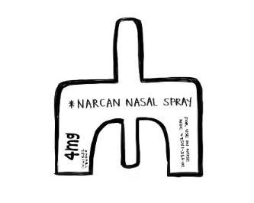
How we started…
PROJECT
TIMELINE
ED Quality Collaborative
JUN
2019
10 ED pilot sites
2 opioid summits to scope best practices
Identify ED champions
Build stakeholder engagement
Summit #1
NOV
20
2019
ED Naloxone Rescue Kits
2,400 kits to be distributed free to ED patients
Kits tailored to local naloxone standing order pharmacies
ED site visits for scoping and train-the-trainer education
Summit #2
FEB
27
2020
ED Medication for OUD
Practice
Change
50 new Michigan emergency physicians x-waiver trained
Est. 2015
ED Screening
SEPT
2020
Environmental scan of current ED practice
Scoping and implementing best practices

Slide 30
Pre-Implementation Nurse Assessment
Barriers
Stigma
Education/Time
Facilitators
Resources available for education and kits
Easy process
Integration into current ED
24 hour pharmacy
PYXIS/EHR alerts
Receptivity
Generally receptive
Education Plan
Huddles, in service, train the trainer, department meetings, web-based

Slide 31
Creation of Resources
Tailored Nurse Train-the-Trainer Education PPT
Included video for patient education
Patient education brochures
Naloxone Access Cards
Naloxone kits
Creation of online Emergency Department Naloxone Training
1 CEU
Posters for displaying in the ED
Implementation Guide

Slide 32
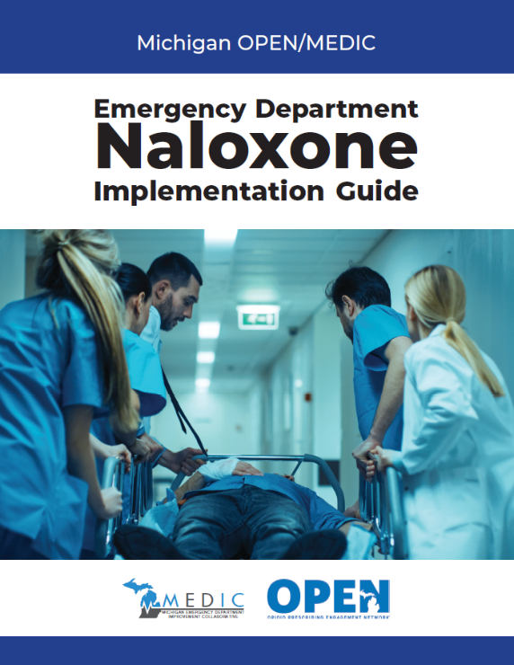
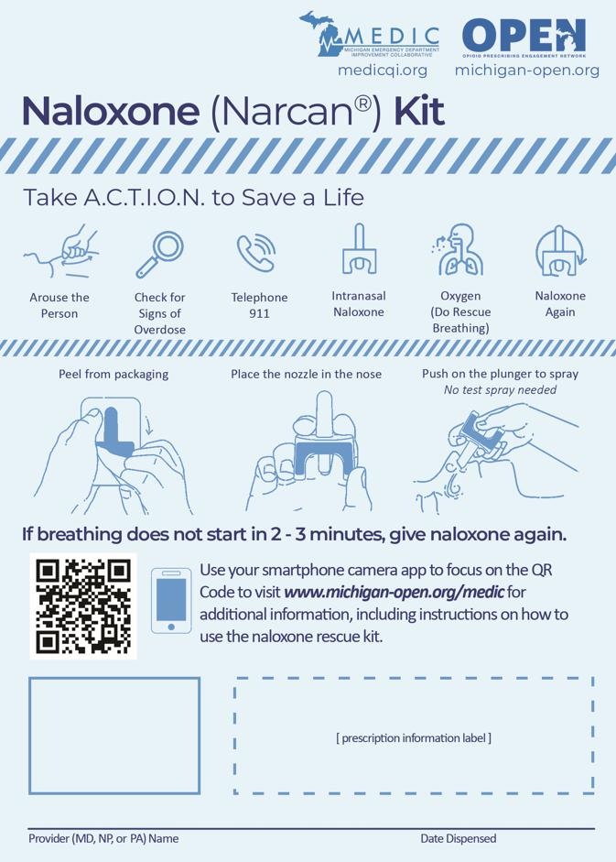
Resources
To view all resources, visit:
michigan-open.org/initiatives/medic-open
OverdoseACTION
Notes:
Overdose response and naloxone administration videos, naloxone brochures, county-specific naloxone access cards, kit label with overdose response instructions, implementation guide

Slide 33
Where we are…

Slide 34
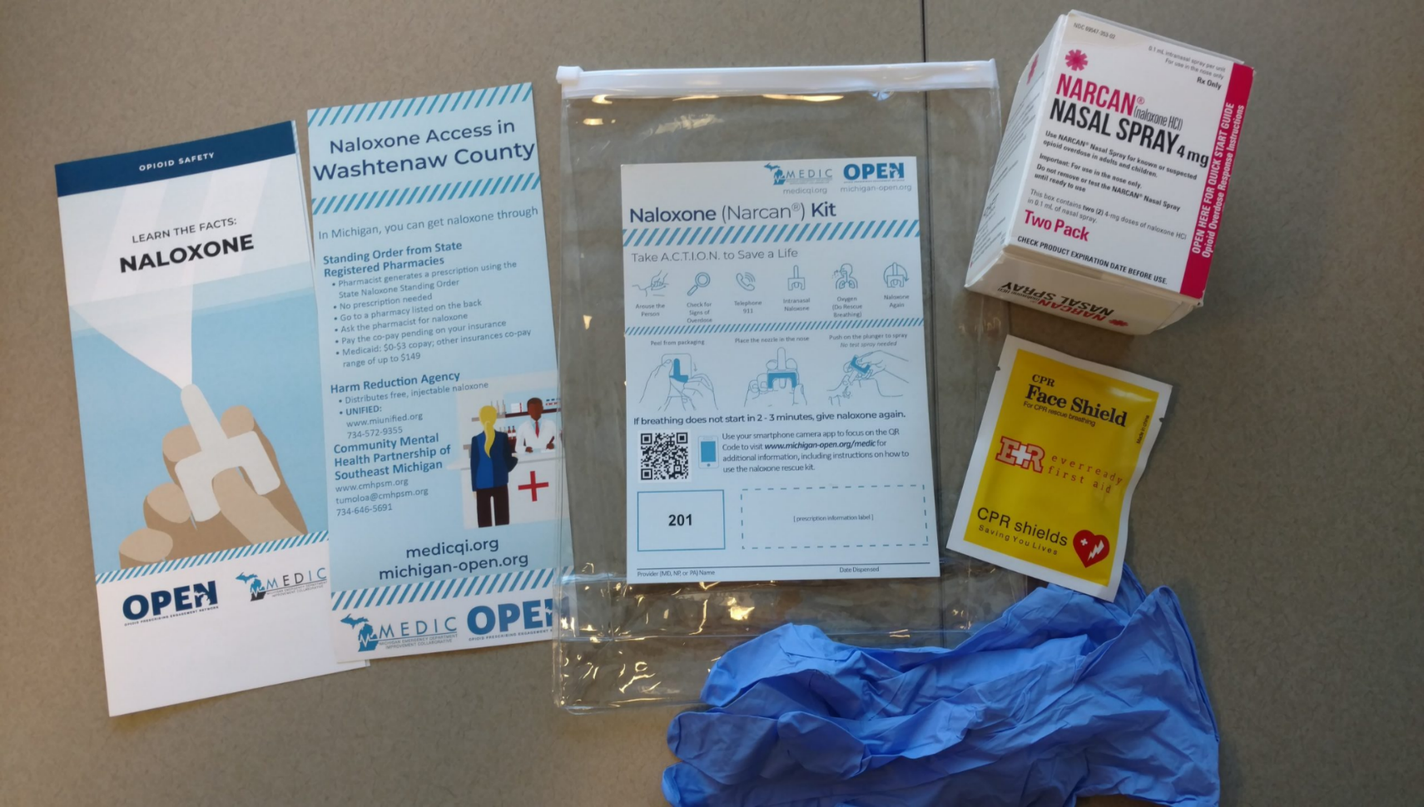
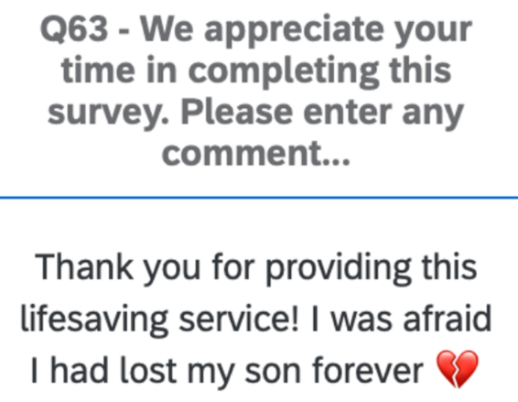
Where we are…
Since 2020:
Assembled
14,800
Shipped
7,000+
Distributed
5,000+
ED Naloxone Rescue Kits

Slide 35
Learning Objectives
Describe the implementation of ED-based naloxone distribution
Discuss common barriers and facilitators to implementation and sustainability
Identify strategies for creating scalability for program expansion

Slide 36
Barriers
Based on program building, local ED experience, qualitative interviews*
Stigma
Knowledge Gaps
ED Processes
* 25 interviews with advanced practice providers, physicians, nurses, pharmacists, social workers,
peer recovery coaches @ 4 hospitals in the program varying by region, demographics, ED type
Notes:
Gina: describe qualitative interviews

Slide 37
Facilitators/Stigma
Provide safe space for ED staff conversations
Share patient stories
Empower advocates
“Often how we’ve gotten the best success is to tell stories that remind people that this could be your neighbor, your friend, your family member that’s impacted in a positive way. Because the more naloxone we get out into the community, the safer everyone really is.”
- ED Clinical Nurse Specialist
Notes:
Keith to take over and discuss facilitators

Slide 38
Facilitators/Knowledge Gaps
Build a coalition
Identify and empower clinical champions
Obtain leadership and frontline buy-in
Educate ED staff
Collect data on program impact
“I think that the culture has continued to drive towards recognizing that substance use and behavioral health crises are really a true emergency in the ED…. I think now naloxone distribution is not viewed as much as a new, novel idea. I think it’s really becoming more of an obligation and a standard of care..”
- ED Clinical Nurse Specialist

Slide 39
Facilitators/Developing ED Processes
Establish the urgency of the problem
Make the right thing the easier thing:
Protocols and standardization
Order sets
Automated alerts
Create workflows:
Role clarity – clinicians, nursing, pharmacy
Address operational considerations
Learn and adapt with local tailoring
Audit and feedback

Slide 40
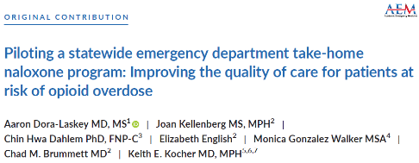
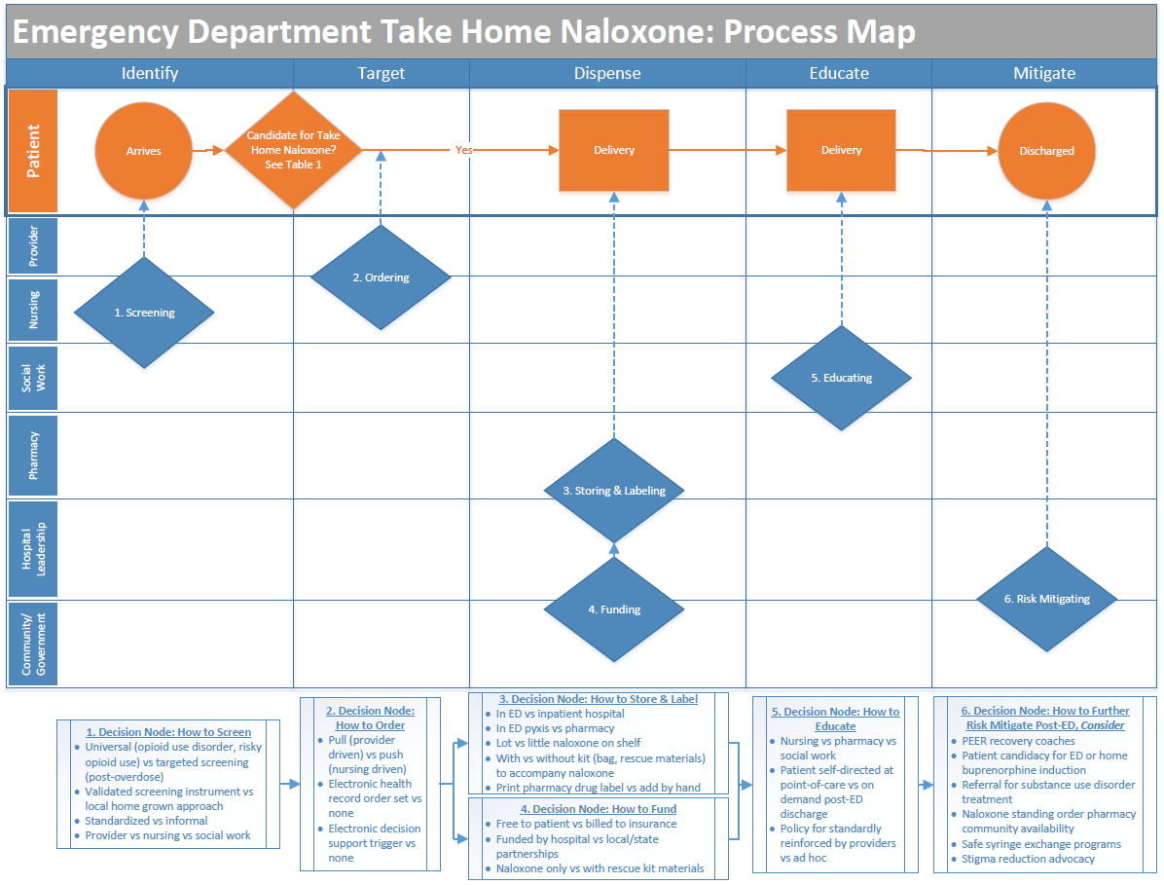
Facilitators/Developing ED Processes

Slide 41
Learning Objectives
Describe the implementation of ED-based naloxone distribution
Discuss common barriers and facilitators to implementation and sustainability
Identify strategies for creating scalability for program expansion

Slide 42
Sustaining and Scaling
People
Value
Funding

Slide 43
People
Invest in those that do the work
Physicians
Nurses
Pharmacists
Build a shared sense of community responsibility
Continuous education
“In the very beginning [there was some stigma]. But once we got started, I believe all the staff members have been right on board. I haven’t heard any negativity. I haven’t heard anything about ‘this is not a great program.’ Actually, I’ve heard great things about it, so I think it’s been working well.”
- ED Nurse Educator

Slide 44
Value
Embedding naloxone in ED culture + community
Communication:
Telling the story of success consistently inside and outside the unit
Maintain process
Reinforce feedback loops
Measurement and reporting

Slide 45
Funding
Naloxone, naloxone, naloxone!
EDs serve uninsured, underinsured
Potential models of funding:
State
Community
Hospital
Payer
“[If funding ends] people are going to die. We’re going to see tons of deaths via overdose. Yeah, I think that that is going to be the outcome. I think that it’s saved a lot of lives.”
- ED Social Worker
“I think it’s really going to be down to, can we continue to provide the medication for free?”
- ED Physician

Slide 46
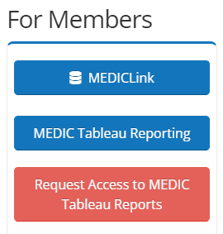
What’s Next?
https://medicqi.org/

Slide 47
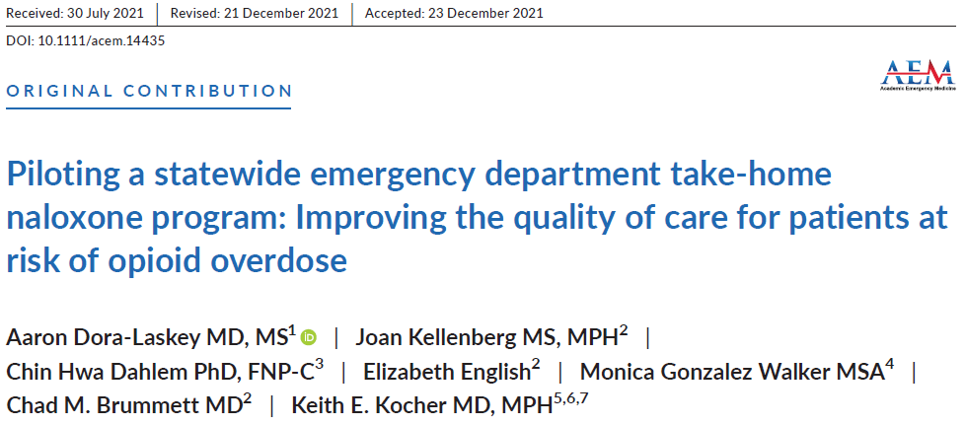
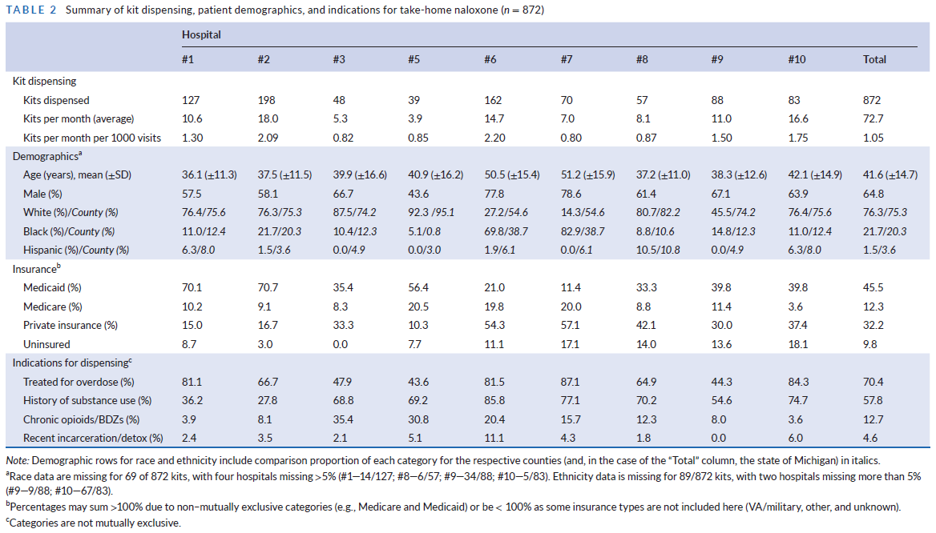
Where to Learn More
https://michigan-open.org/initiatives/medic-open/

Slide 48
Thank you!
Chad Brummett, MD
Keith Kocher, MD, MPH
Gina Dahlem PhD, FNP-C, FAANP
@drchadb
@kekocher
Michigan-OPEN.org
medicqi.org

